Slide 2
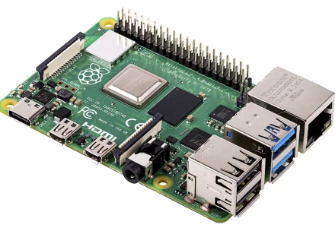
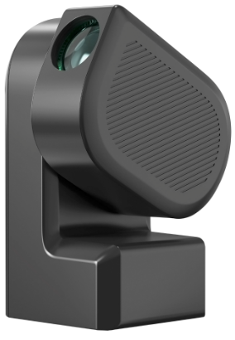
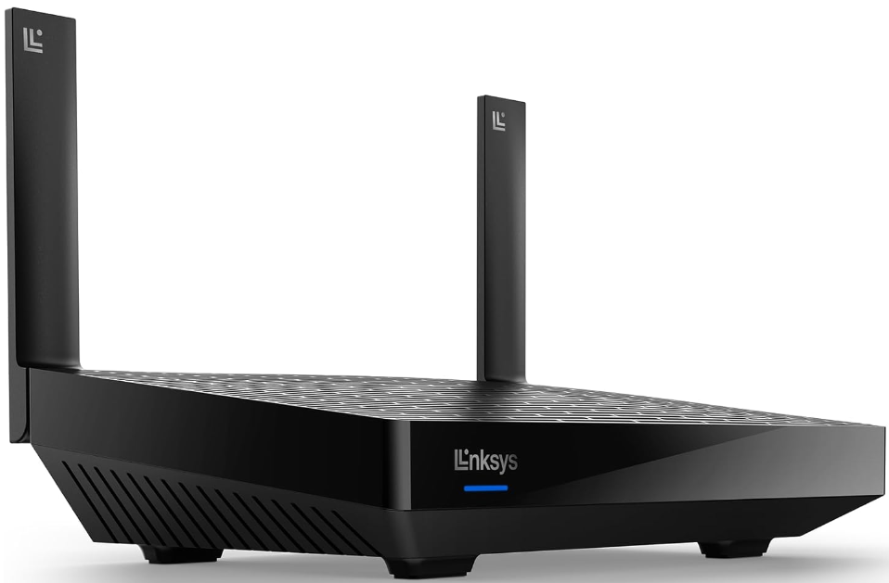
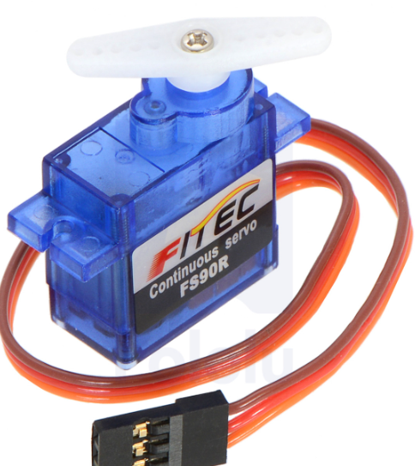
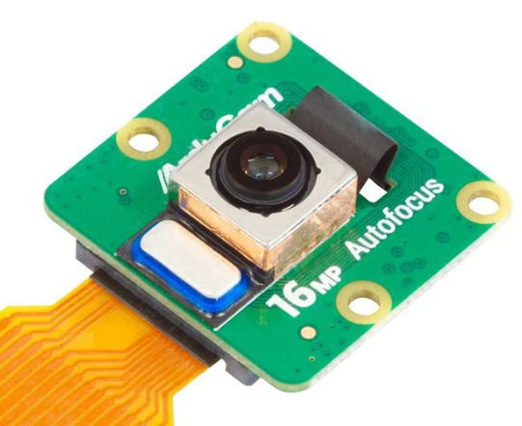
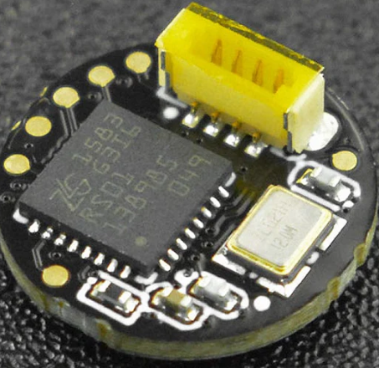
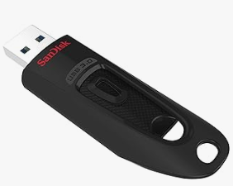
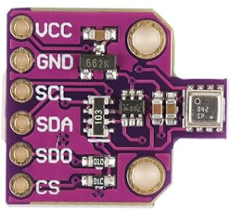
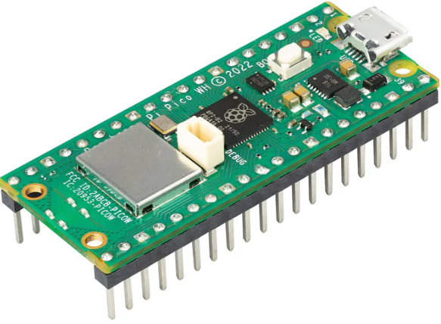
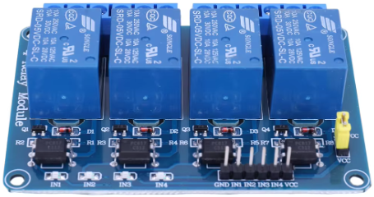


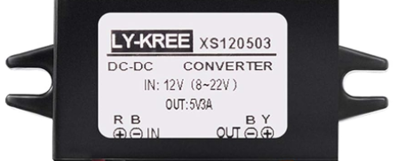

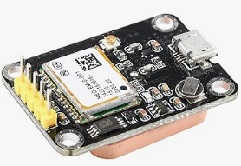
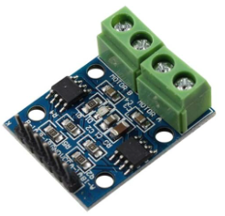


CRAYSTATION SCHEMATIC
RPi 4: Android & SeeStar App
ZWO SeeStar S50
Router
WiFi
Bluetooth
WiFi
All sky cam
Servo to power on and off
WiFi
5V
WiFi
RPi 4: Raspian desktop User control software
Rain detector
Serial Comms
5V
USB storage
5V
Pico W
Temp, pressure, humidity
Relays for control power to RPi s
12v to 5v
5V
Solar panel 10W
Wind speed
7ah 12V Battery
12V
Enclosure motor
GPS
12V
12V
Regulator
Motor controller

